Slide 1

Channel Architecture
Routes.php
Campaign.add
Campaign.edit
Campaign.copy
Campaign.delete
campaign.updateStatus
Routes-web.php
campaign.add.form
campaign.edit.form
Campaign.copy.form
Campaign.delete.form
campaign. export
Campaign.import
Campaign.php
Lib/control
Darknet-YOLO model training
lib
Campaign-form-add.twig
Campaign-form-edit.twig
Campaign.twig
Campaign-form-delete.twig
Campaign-form-copy.twig
Views
Lib/factory
CampaignFactory.php
LayoutFactory.php
NotificationFactory.php
mysql
Lib/entity
Table:
Campaign
Lkcampaignlayout
Notification
lknotificationuser
Campaign.php
Zhonglong Chen
2018/9

Slide 2
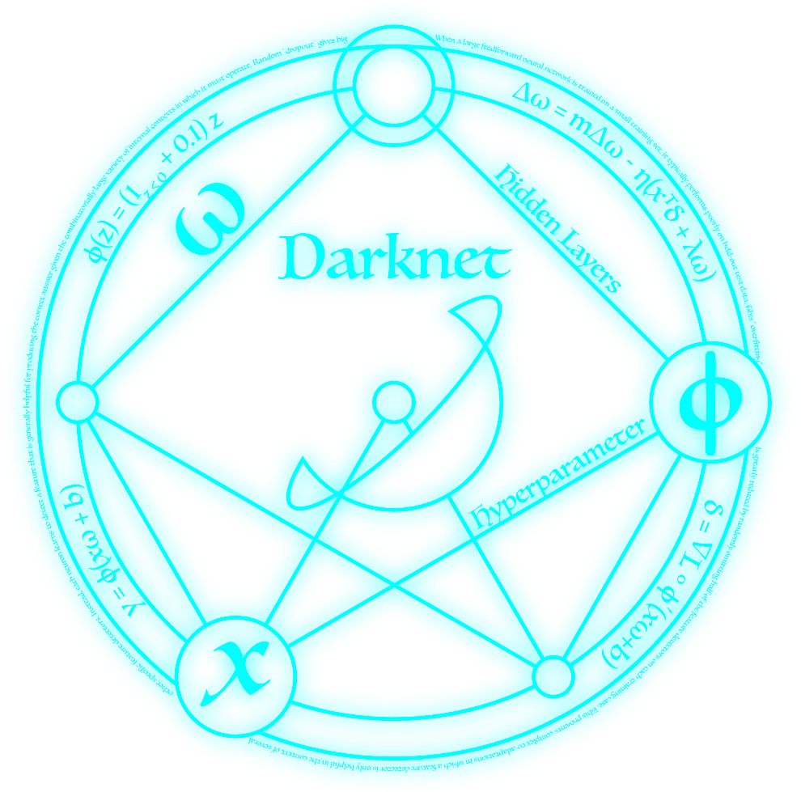
Darknet: Open Source Neural Networks in C
Darknet is an open source neural network framework written in C and CUDA.
It is fast, easy to install, and supports CPU and GPU computation.

Slide 3
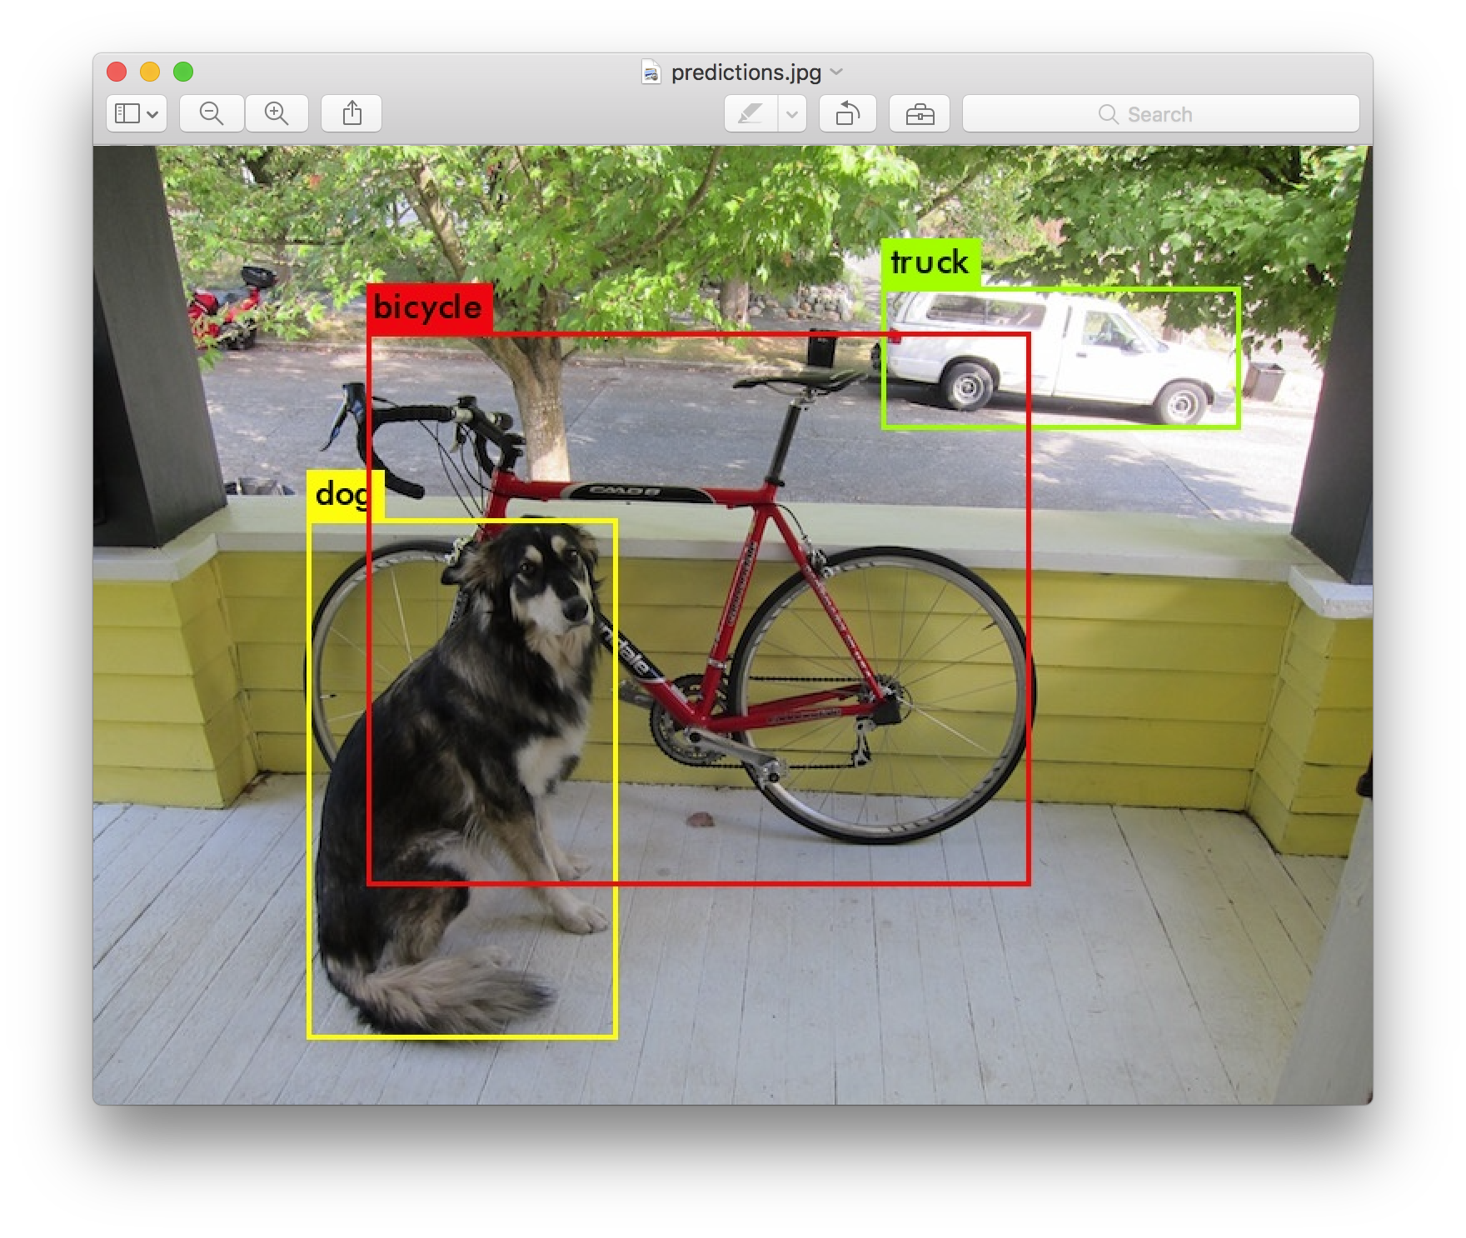
YOLO: Real-Time Object Detection
You only look once (YOLO) is a state-of-the-art, real-time object detection system.

Slide 4
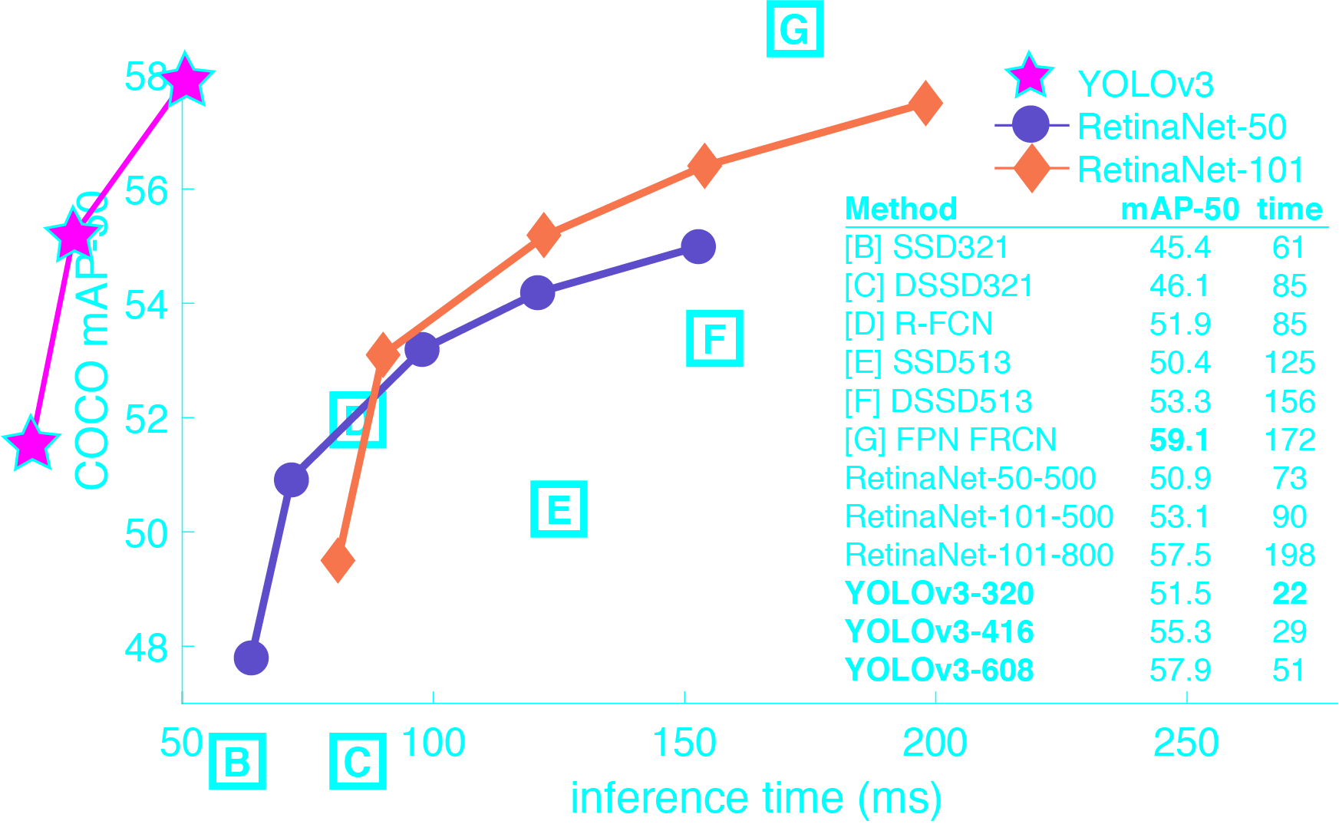
Why do we choose YOLO v3?
Compatibility
support Linux, Windows, Android, Raspberry Pi, …
Performance

Slide 5
YOLO v3 tiny on X588/ARMv8
We have a very small model as well for constrained environments, yolov3-tiny.
We can easily tradeoff between speed and accuracy simply by changing the size of the model,
no retraining required!
On X588
CPU: MT6750
RAM: 3G
Each image takes less than one second.

Slide 6
Darknet-YOLO source code
cfg
voc.data
coco.data
yolov3-voc.cfg
yolov3.cfg
yolov3-tiny.cfg
yolov3-tiny-voc.cfg
data
voc.names
coco.names
scripts
voc_label.py
get_coco_dataset.sh
darknet
darknet53.conv.74
yolov3-tiny.conv.15

Slide 7
How to train a YOLO v3 model
(1) Get Data:
Pascal VOC, MS COCO, ImageNet
(2) Generate Labels:
each image with a line for each ground truth object in the image that looks like:
<object-class> <x> <y> <width> <height>
(3) Modify Cfg:
xxx.data, xxx.cfg
(4) Download Pretrained Convolutional Weights
(5) Train The Model

Slide 8

(1) Dataset: Pascal VOC
classes
20 training set:
VOCtrainval_11-May-2012.tar(1.86G) VOCtrainval_06-Nov-2007.tar(438M)
test set:
VOCtest_06-Nov-2007.tar(430M)
Images:
training :16551
test: 4952
Official: http://host.robots.ox.ac.uk/pascal/VOC/index.html
Mirror: https://pjreddie.com/projects/pascal-voc-dataset-mirror/

Slide 9

(1) Dataset: MS COCO
classes
80 training set:
train2014.zip(12.5G)
test set:
val2014.zip(6.18G)
Images:
training : 117264
test: 5000
Official: http://mscoco.org/
Mirror: https://pjreddie.com/projects/coco-mirror/

Slide 10
(2) Labels
Now we need to generate the label files that Darknet uses.
Darknet wants a .txt file for each image with a line for each ground truth object in the image
that looks like:
<object-class> <x> <y> <width> <height>
Where x, y, width, and height are relative to the image's width and height.
Generate Labels for VOC
run the voc_label.py script in Darknet's scripts/ directory
Generate Labels for COCO
run the script scripts/get_coco_dataset.sh

Slide 11
(3) Modify Cfg: xxx.data
classes: kinds of objects
train: training image path list, one line for each image
valid; test image path list, one line for each image
names: object name list, one line for each object
backup: directory to store model file
Pascal VOC
classes= 20
train = <path-to-voc>/train.txt
valid = <path-to-voc>2007_test.txt
names = data/voc.names
backup = backup
MS COCO
classes= 80
train = <path-to-coco>/trainvalno5k.txt
valid = <path-to-coco>/5k.txt
names = data/coco.names
backup = backup

Slide 12
(3) Modify Cfg: xxx.cfg
max_batches: batches for training, at least 2000 times for each class
steps: decrease learning rate gradually to the end of training
filters: (classes + 5) x 3, depend on classes
classes: kinds of objects
 | Pascal VOC dataset | COCO dataset
max_batches | 50200 | 500200
steps | 40000,45000 | 400000,450000
filters | 75 | 255
classes | 20 | 80

Slide 13
(4) Pretrained Convolutional Weights
For training we use convolutional weights that are pre-trained on Imagenet.
YOLO v3
We use weights from the darknet53 model.
We just download the weights for the convolutional layers(76 MB).
wget https://pjreddie.com/media/files/darknet53.conv.74
YOLO v3 tiny
Get pre-trained weights yolov3-tiny.conv.15 using command:
./darknet partial cfg/yolov3-tiny.cfg yolov3-tiny.weights yolov3-tiny.conv.15 15

Slide 14
(5) Train The Model
YOLO v3
Pascal VOC
./darknet detector train cfg/voc.data cfg/yolov3-voc.cfg darknet53.conv.74
MS COCO
./darknet detector train cfg/coco.data cfg/yolov3.cfg darknet53.conv.74
YOLO v3 tiny
Pascal VOC
./darknet detector train cfg/voc.data cfg/yolov3-tiny-voc.cfg yolov3-tiny.conv.15
MS COCO
./darknet detector train cfg/coco.data cfg/yolov3-tiny.cfg yolov3-tiny.conv.15
It will take a very long time. Keep waiting.

Slide 15
Practice: YOLO v3 tiny
172.20.30.7
Only CPU computation
Each batch takes 30 ~ 90 seconds, depends on the dynamic image resolution.
We use over one day to train model for only one object.
172.20.30.50
With GPU computation
Each batch takes only one second, depends on the dynamic image resolution.
We use nearly one day to train model on Pascal VOC dataset.

Slide 16
Reference
Darknet
https://pjreddie.com/darknet/
YOLO
https://pjreddie.com/darknet/yolo/
Github
https://github.com/pjreddie/darknet/
How to train
https://github.com/AlexeyAB/darknet#how-to-train-to-detect-your-custom-objects

